Slide 1
Introducing a mathematical method to use a Solar Power Meter for non-solar spectra
Sarina Wunderlich www.licht-im-terrarium.de
18.06.2023

Slide 2
Physically the Solar Power Meter works by converting light into current in a photo diode
Heart of the Power Meter is a Silicon photodiode
This is underneath a diffusor cap, that makes sure, that light from all directions reach the sensor
The Silicon photodiode generates an electrical current, when light reaches it
The electronics inside the meter convert this current into a number
During the calibration process, the factor or gain is determined, which is needed to multiply the electrical current so that the correct reading is displayed for the calibration light source.

Slide 3
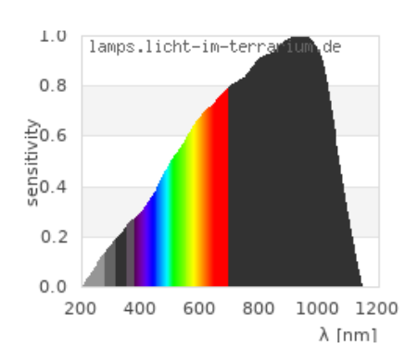
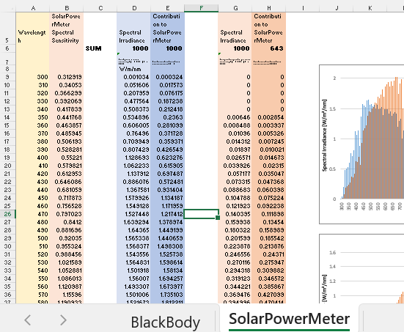
For different light spectra, it makes sense to describe the function by a formula
Not all wavelengths contribute equally to the current of the photodiode. Some wavelengths are not recognized by the photodiode at all.
A typical response of a Silicon photodiode is shown on the right, it stretches from 300 to 1100 nm with a peak around 950 nm
The number displayed by the meter can be calculated from the light spectrum S and the Power Meter response A as: $\int{S\left(λ\right)⋅A\left(λ\right) dλ}$
$S\left(λ\right)⋅A\left(λ\right)$means: For every wavelength $λ$ the intensity of the light $S\left(λ\right)$ and the response strength of the meter $A\left(λ\right)$ are multiplied
$\int{S\left(λ\right)⋅A\left(λ\right) dλ}$ means: Then all contributions to the meter are summed up
I provide an Excel file to do the calculation

Slide 4
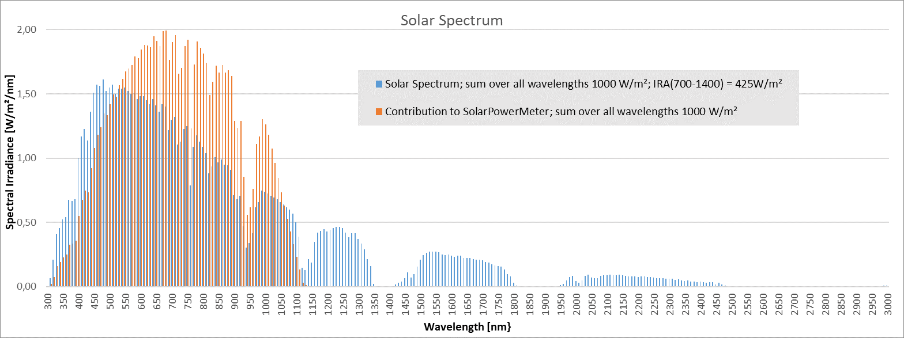
Example: Sunlight – even though meter sees only part, calibration ensures correct reading
The solar spectrum has a total power density of 1000 W/m²
The Silicon photodiode does not see the full spectrum, it only responds to 400 – 1100 nm
While the solar spectrum has intensities at 1200 nm and 1600 nm, the meter does not see that
While the solar spectrum has its peak intensity around 500 nm, the wavelength contributing most to the Power Meter reading is at 700 nm
However, during calibration, the gain of the diode has been increased by almost a factor of 2 at around 950 nm
Thus, the sum over all contributions to the Power Meter equals 1000 W/m² - This is ensured by the calibration process

Slide 5
Example: Sunlight – even though meter sees only part, calibration ensures correct reading
Peak of solar spectrum around 500 nm
700 nm contributes most to the Power meter reading
High gain:  Contribution above 500 nm is higher than actual intensity.
⧫ Contribution at 950 nm almost twice as high as the actual intensity!
The meter correctly reads 1000 W/m², even though it measures something completely different
Intensity not seen by the meter

Slide 6
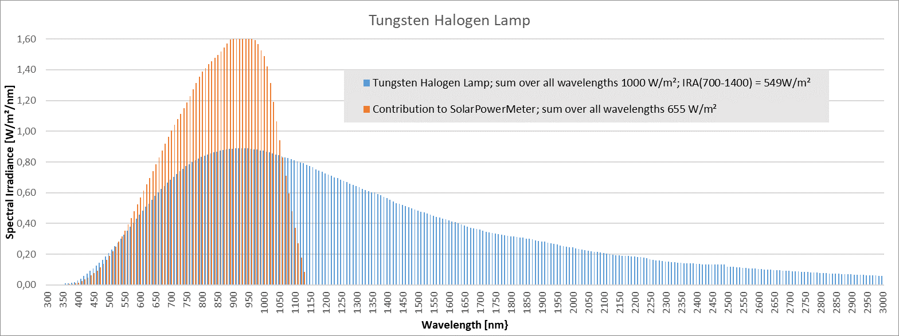
Example Tungsten Halogen: calibration no longer works, but by chance the reading matches IRA
High gain:  Contribution above 500 nm is higher than actual intensity.
⧫ Contribution at 950 nm almost twice as high as the actual intensity!
Intensity not seen by the meter.
However, the meter reading is close the amount of IRA (700 – 1400 nm). This is just a coincidence!
The proportion of light seen by the meter is much lower for the halogen lamp compared to sunlight!
The meter by far under-estimates the total power!

Slide 7
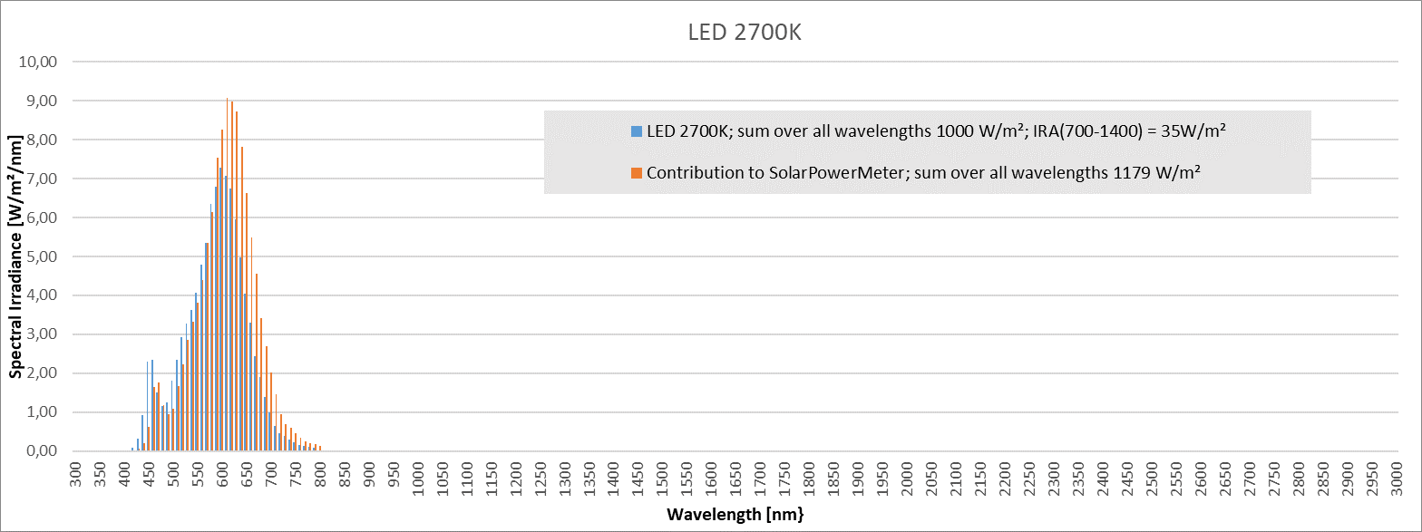
Example White LED (2700 K): The meter reading is slightly higher than the acutal power
High gain: Contribution above 500 nm is higher than actual intensity.
LEDs emit hardly any radiation above 700 nm.
The proportion of light seen by the meter is slightly higher for the white LED. The meter slightly over-estimates the total power.

Slide 8
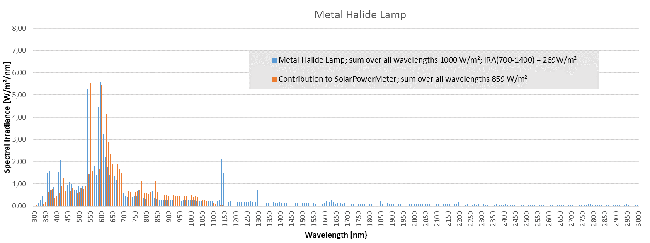
Example Metal Halide: The meter slightly under-estimates the total power
High gain:  Contribution above 500 nm is higher than actual intensity.
⧫ Contribution at 950 nm almost twice as high as the actual intensity!
Metal halide lamps only emit a small portion of its power in the IRA-band
The proportion of light seen by the meter is slightly lower for the metal halide lamp. The meter slightly under-estimates the total power.
Intensity not seen by the meter.

Slide 9
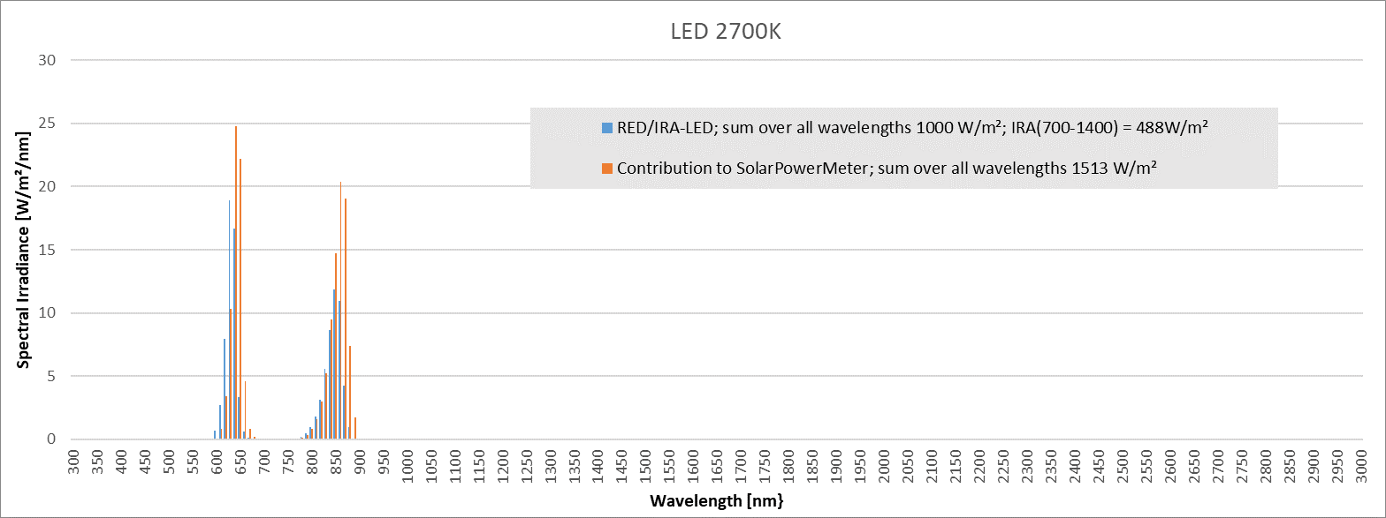
Example Red/IR LED: lamp emits only in the high-gain-region, thus the meter over-estimates power
High gain:  Contribution above 500 nm is higher than actual intensity.
Contribution at 950 nm almost twice as high as the actual intensity!
ALL of the lamp’s emission is in the high-gain-area!
The proportion of light seen by the meter is higher for the RED/IRA-LED lamp. The meter over-estimates the total power.
The lamp does not emit any wavelength that is not seen by the meter

