Slide 1
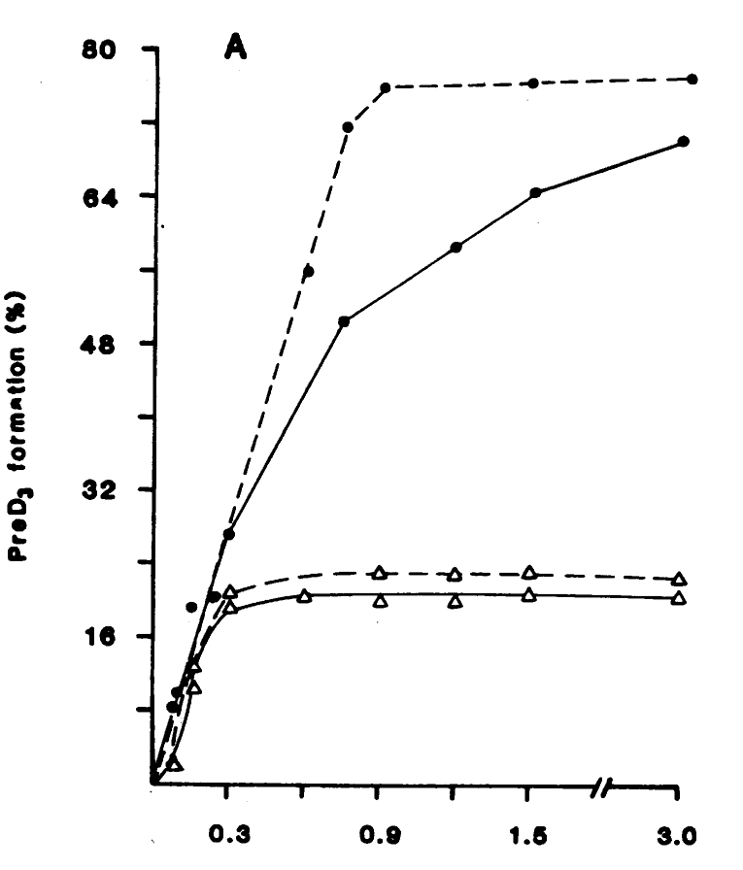
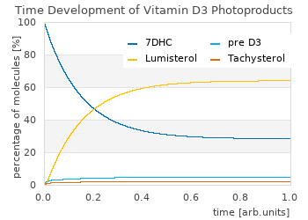
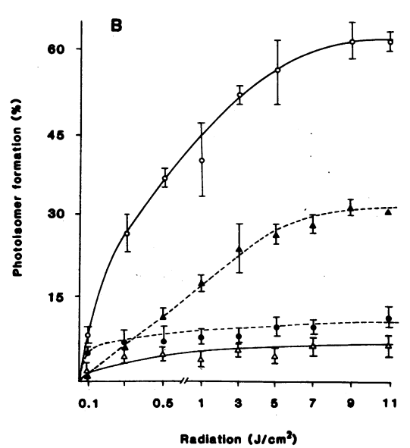
80% preD3 when exposed to 290-302 nm narrow band (solid line = in human dermis)
lamps.licht-im-terrarium.de
Calculation for every spectrum
20% preD3 when exposed to simulated sunlight (solid line = in human dermis)
Fig 2 from MacLaughlin, J., Anderson, R. & Holick, M. F. (1982) Spectral character of sunlight modulates photosynthesis of previtamin D3 and its photoisomers in human skin. Science, 216 1001–1003.
60% Lumisterol when exposed to simulated sunlight
30% Tachysterol when exposed to 290-302 nm narrow band
~10% Lumisterol when exposed to 290-302 nm narrow band
~8% Tachysterol when exposed to simulated sunlight

